Slide 1
Winter 2011
ECE 162B
“Solid State Device Applications:
Light emitting diodes, Lasers & electronic devices”
Prof. Steven DenBaars
ECE and Materials Depts
Solid State Lighting & Display Center
University of California Santa Barbara, USA

Slide 2
Applications of GaN and related semiconductor p/n junction materials

Slide 3
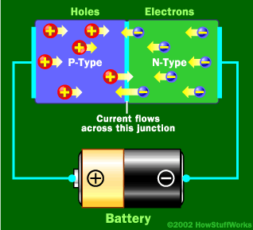
LEDs
Forward Bias p-n junction:
Light is created by flowing current from battery

Slide 4
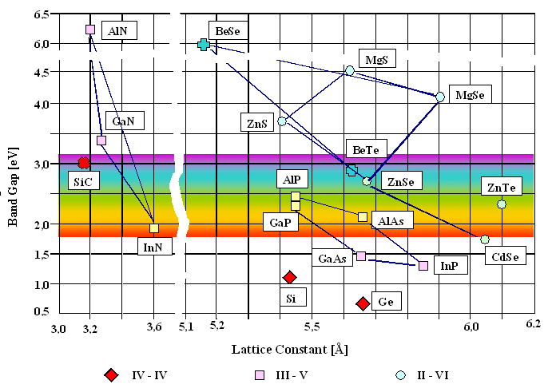
Wide Bandgap Semiconductors generally accepted as semiconductors with Eg larger than 2.5eV
diamond
WBS
ZnO

Slide 5
Rugged Solid-State Device
LED Chip
+lead
GaN Blue and Green LEDs
-lead

Slide 6


Slide 7
Double Heterostructures

Slide 8
Double Heterostructures

Slide 9
GaN LED Historical Development
Cree
186lm/W
CCT 4577K in Dec 2009
150 lm/W with 3.6V DC
168 lm/W pulsed
193 lm/W with 2.8V, 20mA?
CCT 4002K by UCSB in 2007
U
AlInGaP/GaP
(red, orange, yellow)
Fluorescent
Compact Fluorescent
AlInGaP/GaP
(red, orange)
Incandescent bulb
AlGaAs/GaAs
(red)
GaAsP:N
(red, yellow)
InGaN
(green)
InGaN
(blue)
Thomas Edison’s
first bulb
GaP,Zn:O
InGaN
(blue)
SiC
(blue)
GaAsP

Slide 10
Lighting: Large Electricity Consumption
Lighting is single biggest user of electricity
Incandescent Light Bulb -1-4% efficient
Fluorescent – 15-25% efficient
LED- 25-52% efficient (90% theoretical)

Slide 11
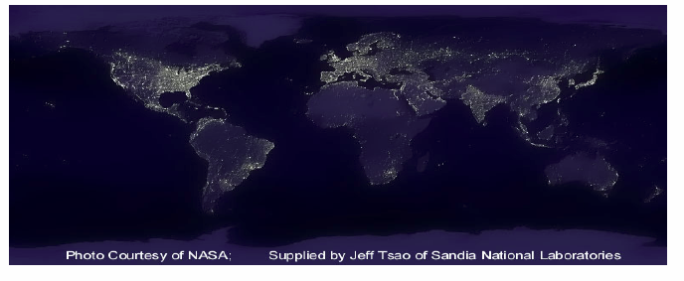
Global Warming/Energy Savings Potential of LEDs
If a 150 lm/Watt Solid State White source were developed, then
in the United States alone:
  We would realize $115 Billion cum. Savings in 2025*
  Alleviate the need of 133 new power stations!*
  Eliminate 258 million metric tons of Carbon*
  Save 273TWh/year in energy**
* “The Promise of Solid State Lighting” OIDA Report , 2001, http://www.netl.doe.gov/ssl/PDFs/oida_led-oled_rpt.pdf
**A. D. Little, “Energy Savings Potential of SSL” Report for Dept. of Energy,
http://www.eere.energy.gov/buildings/info/documents/pdfs/ssl_final_report3.pdf

Slide 12
LED Efficiency: Fundamentals
ηexternall = ηΙnternal * ηoptical
ηΙnternal=1/(1+τradiative/τtnon-radiative)
• Make Radiative lifetime fast
- Engineering Bandgap, quantum structure
• Increase Non-radiative lifetime
- Reduce Defects
- Improve material Purity
e-
Conduction Band
1/τtnon-radiative
1/τradiative=RATE
Valence Band
h+

Slide 13
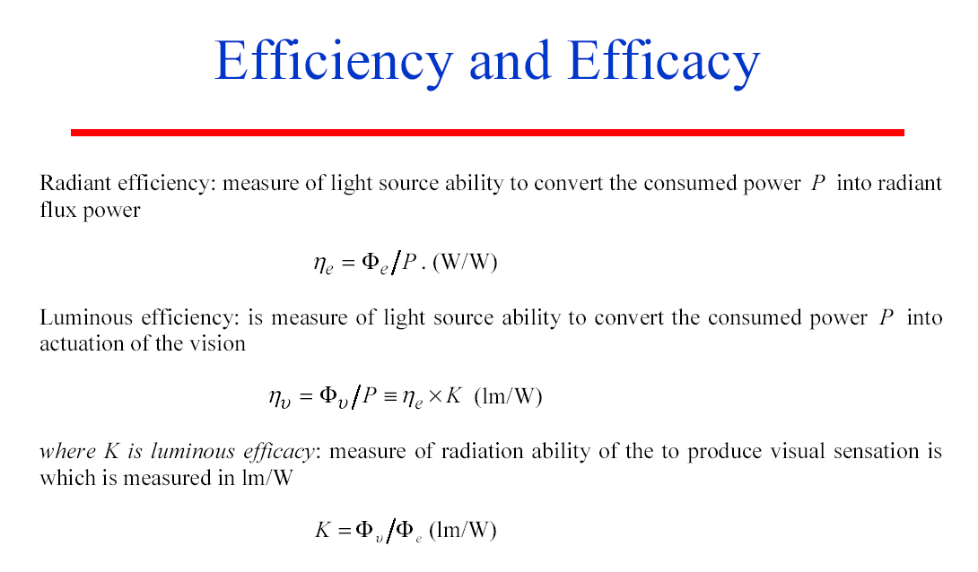

Slide 14
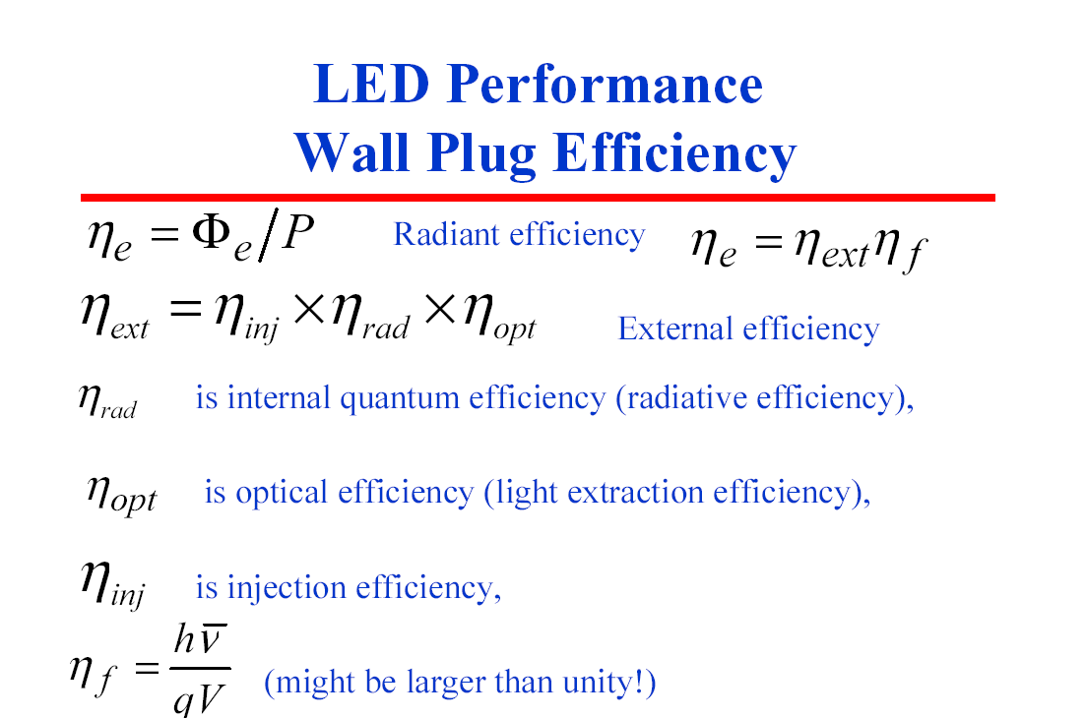

Slide 15
Internal, extraction, external, and power efficiency

Slide 16
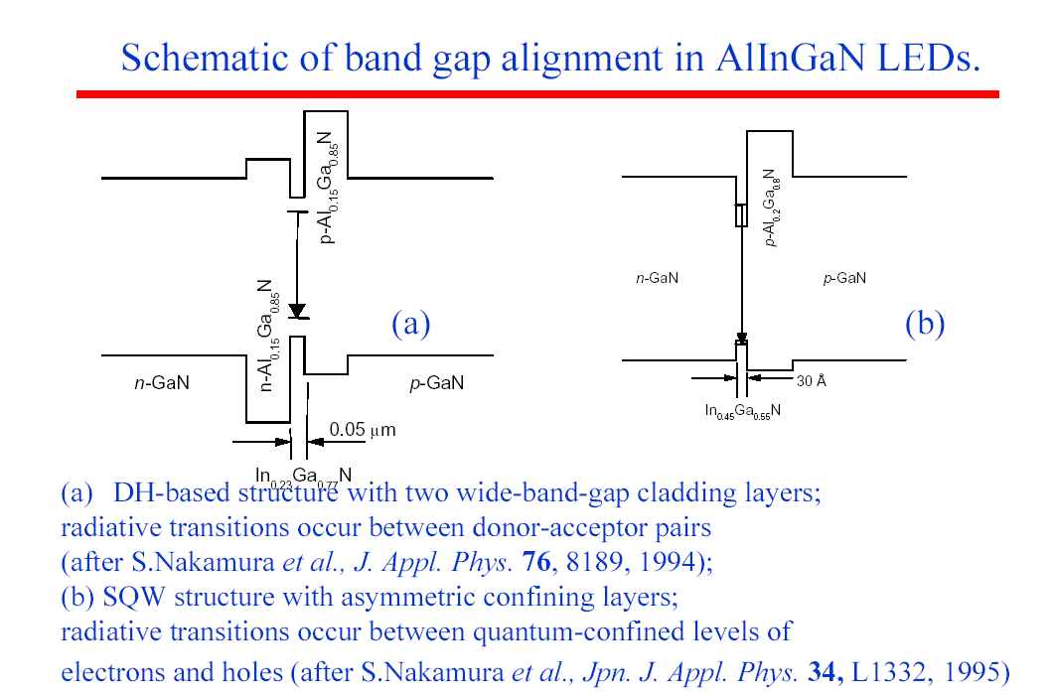
DH vs QW LEDs

Slide 17
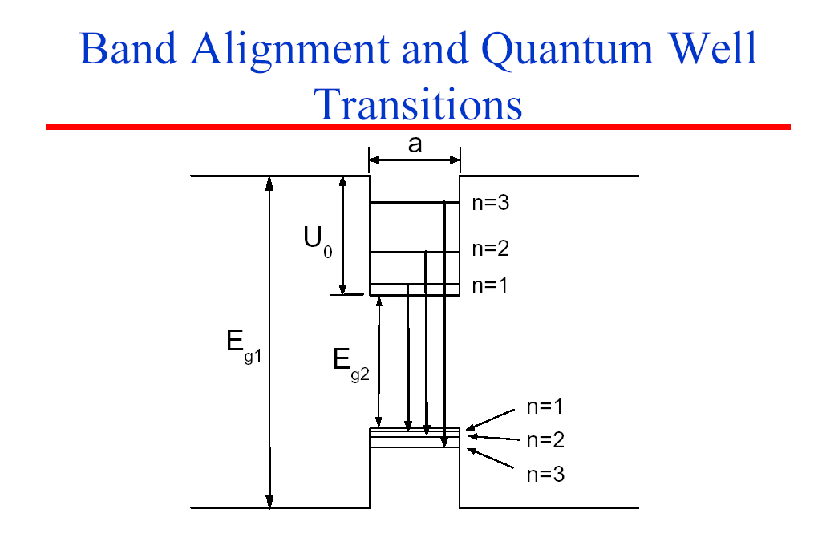

Slide 18
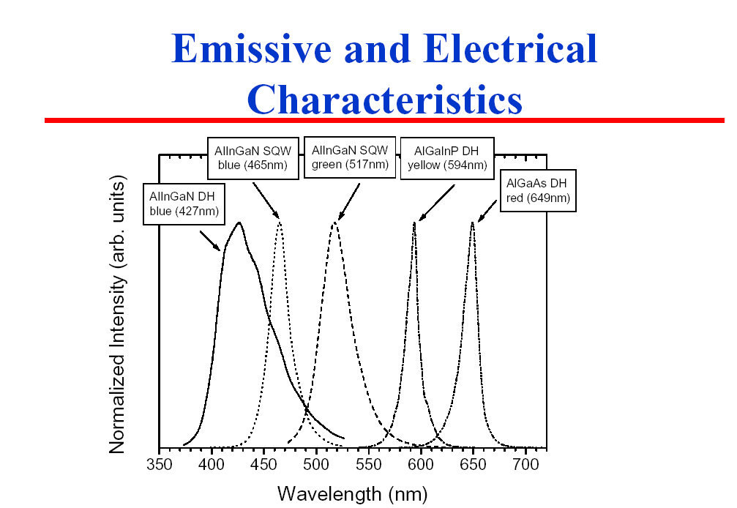
DH LED vs. QW LED
Spectra related to DOS in QW

Slide 19
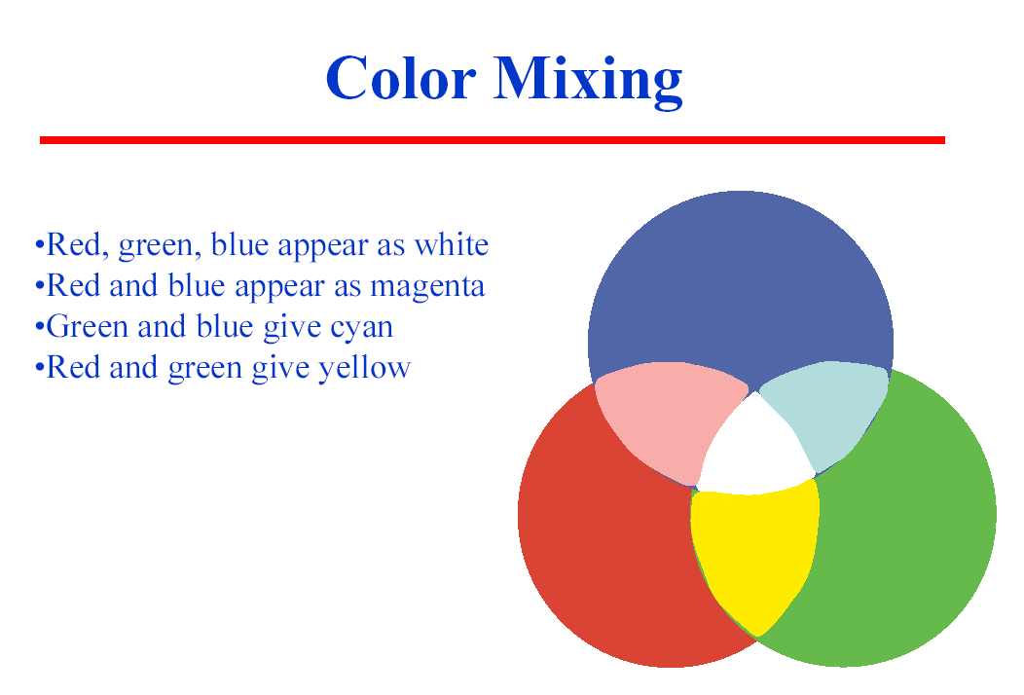
LED Emissive Mixing

Slide 20
3 Methods of Generating White LEDs
White Light
White Light
White Light
RGB Light
Green, Red
phosphors
Blue GaN LED
UV light
Blue Light
UV GaN RCLED
Blue GaN RCLED
Green GaN LED
Substrate
Substrate
UV + Phosphors
-best CRI,color uniformity
-low cost
-improve reliability
Red GaAs LED
Multi-Chip, RGB
-best efficiency
-highest cost
Blue+ Phosphors
-lowest cost
-30lm/W
->90%market share

Slide 21
The first GaN p-n junction LED

Slide 22
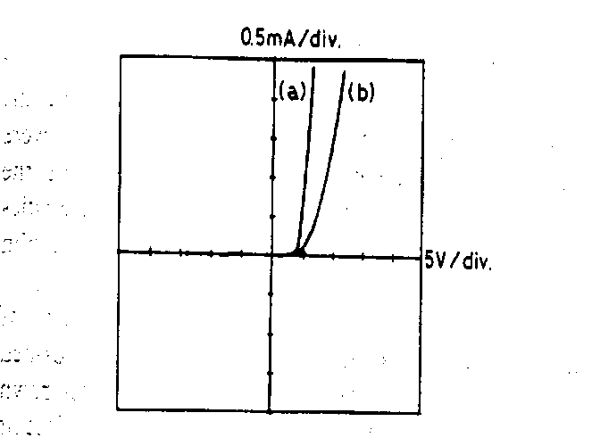
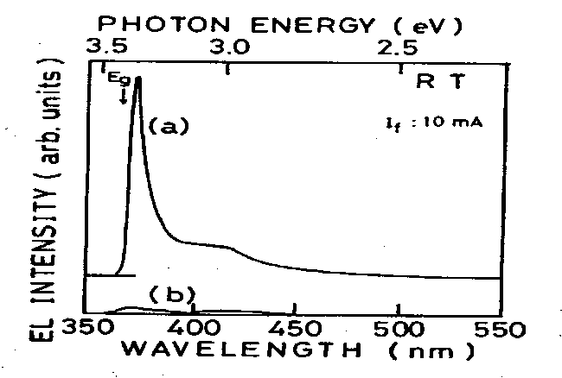
(below): DC-EL spectrum of the p-n junction LED (a) and the conventional m-i-n LED (b) measured at room temperature
(above): I-V characteristics of the p-n junction LED (a) and the conventional m-i-n LED (b)

Slide 23
SEM image of GaN film (a) with and (b) without the AIM buffer layer. No crackes are observed in the former. Bar indicates 10μm

Slide 24
X-Ray rocking curve for (0006) diffraction from GaN grown at 970C with the AIN buffer layer. Dotted line shows data obtained by HVPE.

Slide 25
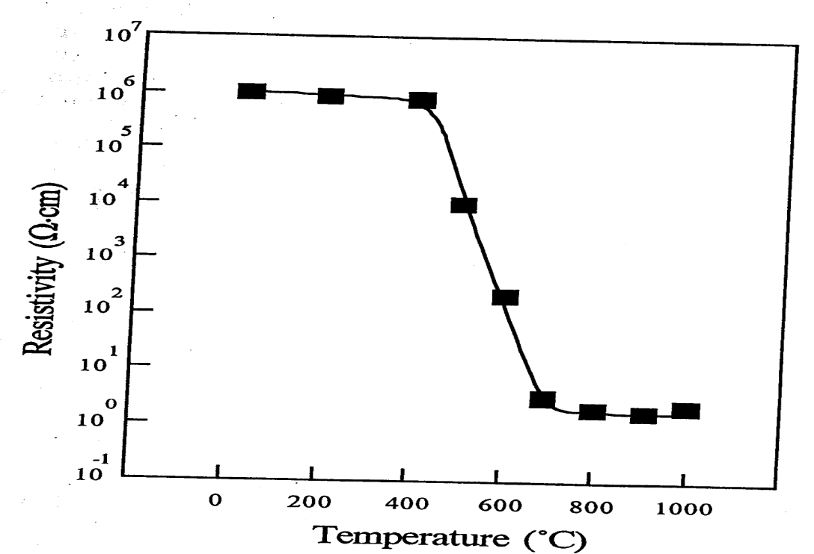
Resistivity of Mg-doped GaN films as a function of annealing temperature (After Nakamura) .

Slide 26
Photoluminescence of Mg-doped GaN films which were annealed at different temperatures: (a) room temp. (b) 700C and (c) 800C.

Slide 27
The resistivity change in LEEBI-treated Mg-doped GaN films as a function of annealing temperature. The ambient gases, NH₃ and N₂ were used for thermal annealing

Slide 28
A shcematic diagram showing the proposed structure of the H-Be complex produced by passivation of Be-doped GaAs. The Be atom is tri-coordinated and the hydrogen is bonded to a neighboring arsenic atom.

Slide 29
Emission Spectrum

Slide 31
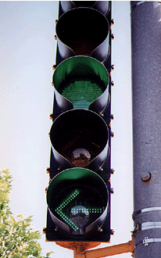
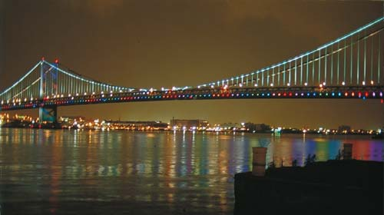
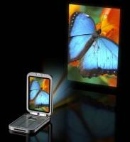
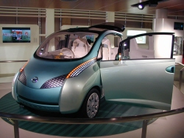
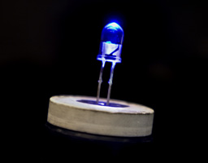
Solid State Lighting Applications
Traffic
Installation Benjamin Franklin Bridge,
PA, USA (Color Kinetics Inc.)
Streetlights
(solar powered)
Cell Phone
(next projectors)
Auto Headlights

Slide 32
3 Methods of Generating White LEDs
150 lm/W (2009)
White Light
White Light
White Light
RGB Light
Green, Red
phosphors
Blue GaN LED
UV light
Blue Light
UV GaN LED
Blue GaN LED
Green GaN LED
Substrate
Substrate
UV + Phosphors
- best CRI,
- color uniformity
- low cost
- improve reliability
Blue + Phosphors
- lowest cost
- 100 lm/W
- 90% market share
Red GaAs LED
Multi-Chip, RGB
- good efficiency
- highest cost
- tunable color

Slide 33
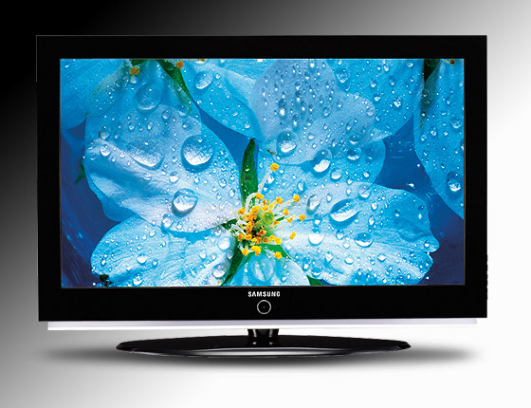
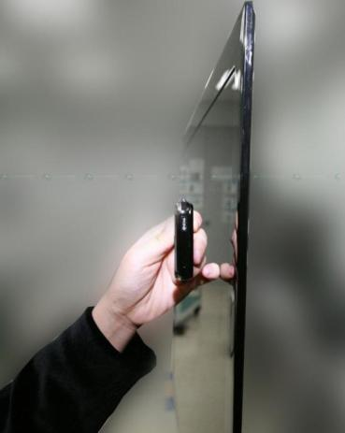
LED TV
6.5mm Thin
The Energy Consumption is reduced up to 40% using LED as a backlight of LCD Display, Energy Star 3.0 Rating
Greenest TV Awards, No Mercury
Samsung LED (LCD) TV #1 Best New TV in 2009

Slide 34
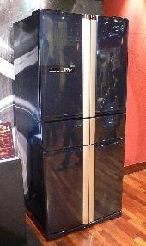
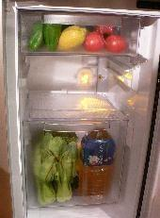
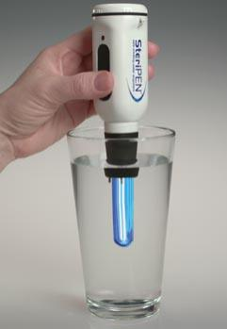
Air/Water Purification
Fruit and Vegetable Storage Life Extended 1 week
Water Purification: UV LED to kill bacteria
Mitsubishi Refrigerator MR-W55H,
UV LED 375 nm, 590 nm, Blue LED
UV Water Purifier
(Credit: Hydro-Photon Inc.)

Slide 35
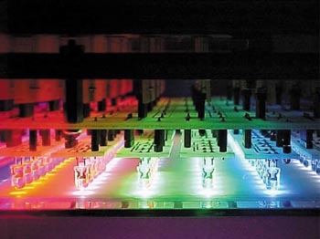
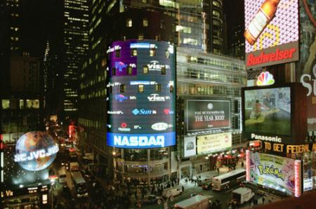
The Advantage of LED Lighting
Long life – lifetimes can exceed 100,000 hours as compared to 1,000 hrs for tungsten bulbs.
Robustness – no moving parts, no glass, no filaments.
Size – typical package is only 5 mm in diameter.
Energy efficiency – up to 90% less energy used
translates into smaller power supply.
Non-toxicity – no mercury.
Versatility – available in a variety of colors; can be pulsed.
Cool – less heat radiation than HID or incandescent

Slide 36
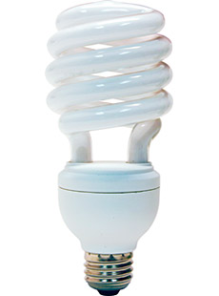
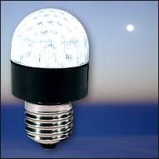
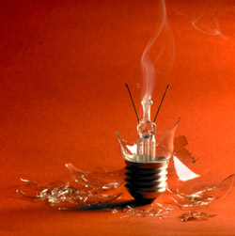
Ban the Light Bulb?
“Ban the Incandescent Light Bulb” gaining momentum
California Legislator Lloyd Levine introduces bill to ban the incandescent light bulb – February 1, 2007
Australia passes legislation to ban the
  light bulb by 2010 – February 21, 2007
EU to ban light bulbs – 2010
United States ????
LED
CFL

Slide 37
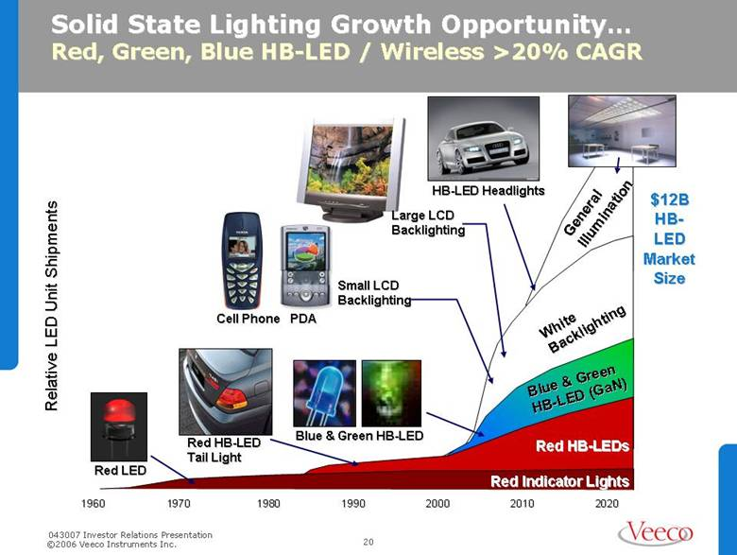
LED Market Size

Slide 38
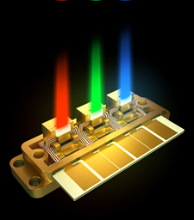
Application: GaN based True Blue and Green Laser Diodes (LDs)
Motivation
  High power blue for LD displays
  Step towards green
WBS Materials Challenges
  Indium incorporation
  Crystal quality & strain
  Optical mode confinement
  Reducing losses
Mitsubishi LaserVue
image source: http://www.engadget.com/2007/06/25/ mitsubishis-laser-tv-coming-to-ces/
Notes:
Motivation for BLUE laser diodes are display technology that employ high power laser diodes. Development in the blue spectrum is also really important for achieving GREEN laser diodes. (next slide)
38

Slide 39

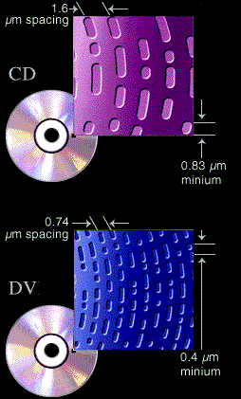
GaN Lasers enables Blu-Ray DVD
Tokyo Japan, SONY annouced next generation large capacity optical disc video recording format called "Blu-ray Disc".
27 gigabytes (GB) on CD/DVD size disc using a 405nm blue-violet laser.

Slide 40

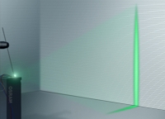
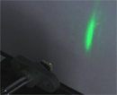
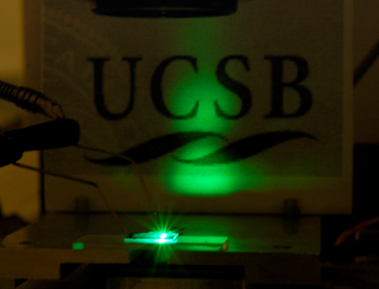
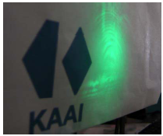
Nitride Green LDs
c-plane
Sumitomo Electric
Nonpolar m-plane
Kaai
UCSB 11-22
514 nm (optical pump)
▲
Osram
Semipolar (20-21)
UCSB
Nichia
UCSB
Wavelength (nm)
Rohm
1995
2001
2010
2007
2008
2009
OSRAM
524
Year
NICHIA
c-plane
518
Sumitomo
(20-21)
AlInGaN clad
531
Kaai
525
Year
UCSB
InGaN/GaN
waveguide
516
Courtesy of APEX, OSRAM web-site, Nikkei Tech-on, SPIE.

Slide 41
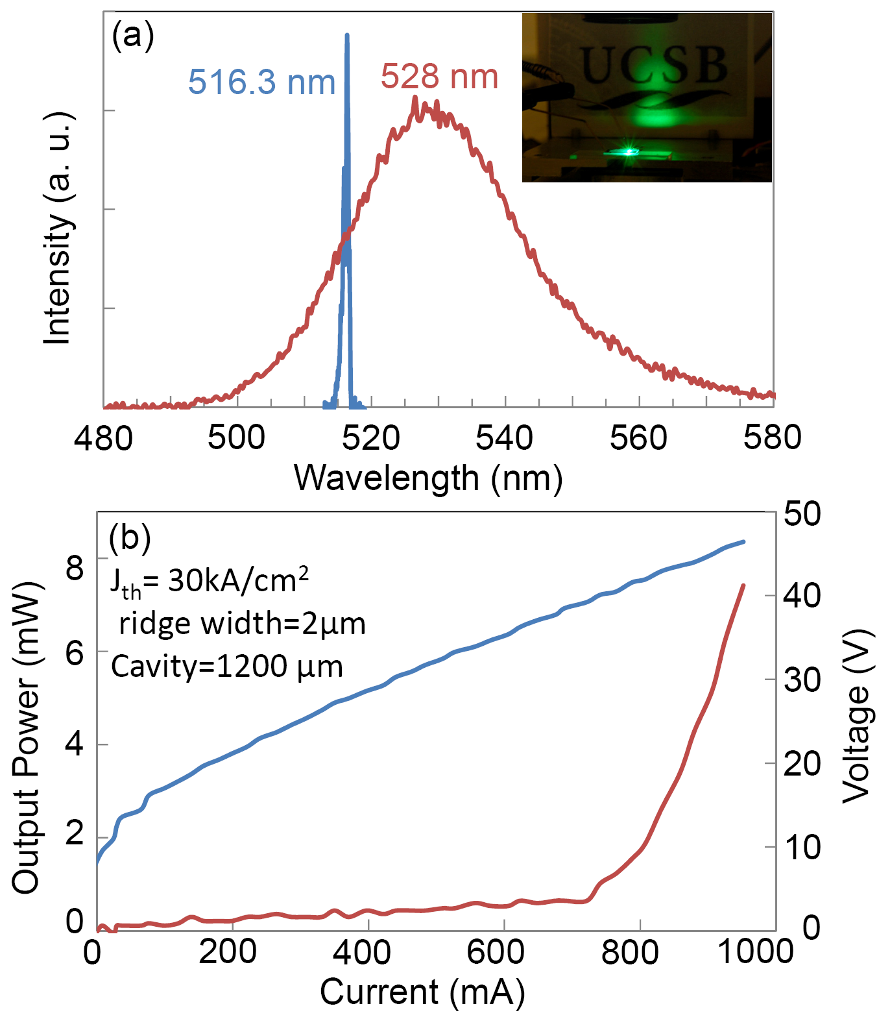
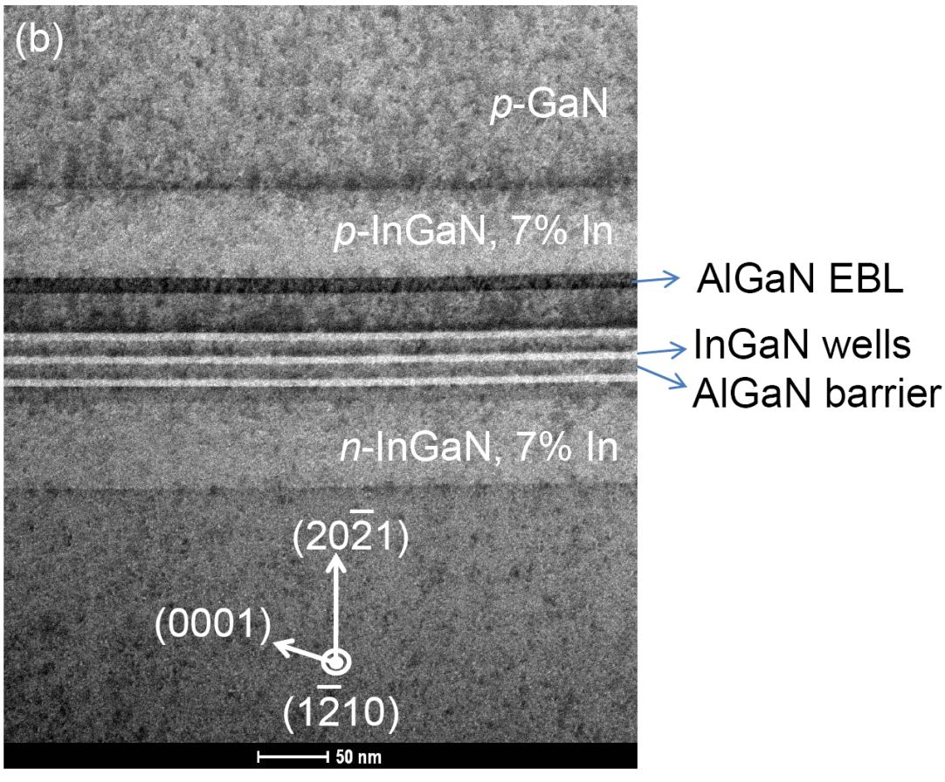
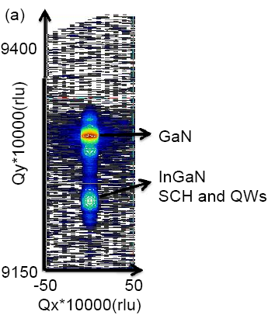
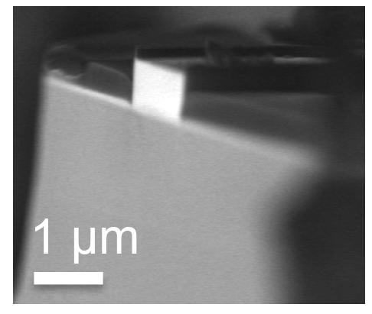
Semipolar (20-21) Green LD (516 nm) by InGaN-waveguide/GaN cladding
TEM courtesy: Dr. Feng Wu

Slide 42
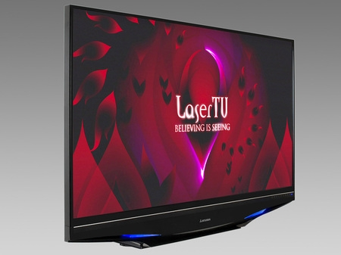
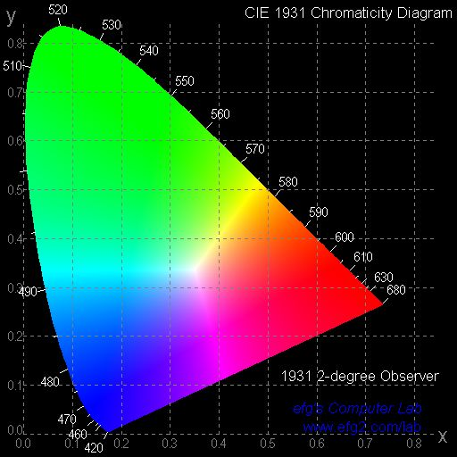

Next generation display
Mitsubishi, 2009
Nonpolar or polar GaN
Laser
InGaAlP
Ref: http://www.mitsubishi-tv.com/product/L65A90/
NTSC
GaN
Ref: http://www.gis.zcu.cz/studium/pok/Materialy/Book/ar03s01.html
Microvision , 2007
Ref: http://www.engadget.com/tag/microvision/

Slide 43
Electronic Device Opportunities

Slide 44
WBS MATERIALS COMPARISON
Material μ ε Eg BFOM JFM Tmax
Ratio Ratio
Si 1300 11.4 1.1 1.0 1.0 300 C
GaAs 5000 13.1 1.4 9.6 3.5 460 C
SiC 260 9.7 2.9 3.1 60 600 C
GaN 1500 9.5 3.4 24.6 80 700 C
BFOM = Balinga’s figure of merit for power transistor performance
JFM = Johnson’s figure of merit for power transistor performance

Slide 45
SiC > 4.5 MV/cm, GaN >2.9MV/cm

Slide 46
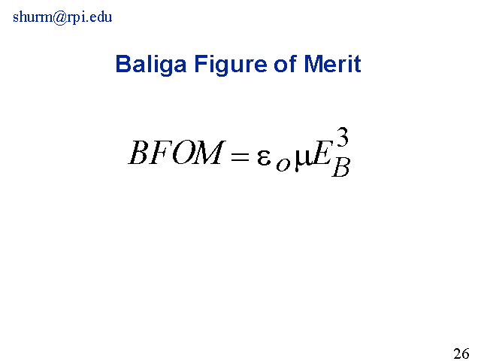

Transistor Figures of Merit
Johnson’s Figure of Merit
Here Eb is the critical electric field for breakdown in the
semiconductor and Vs is the electron saturation velocity

Slide 49
GaN Electronics (HEMT)
High Eletron Mobility Transitor

Slide 50
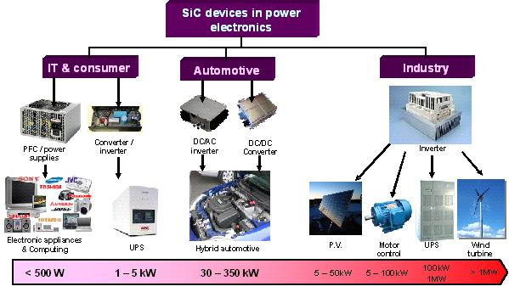
SiC Electronics Application
We will use SiC in hybrid vehicles, says Toyota

Slide 51
Power Electronics

Slide 52
Solid-State Power vs. Frequency
Watts Output

